Slide 1




WOMEN’S HACKATHON
11th Annual UMSL
2025
Empowering #WomenInTech
Brought to you by

Slide 2

WELCOME!
OUR MISSION: Foster innovation, collaboration, and creativity among #WomenInTech.
YOUR OPPORTUNITY: Connect with like-minded individuals, share ideas, and develop solutions that can make a real impact.
Brought to you by
UMSL WOMEN’S HACKATHON 2025

Slide 3
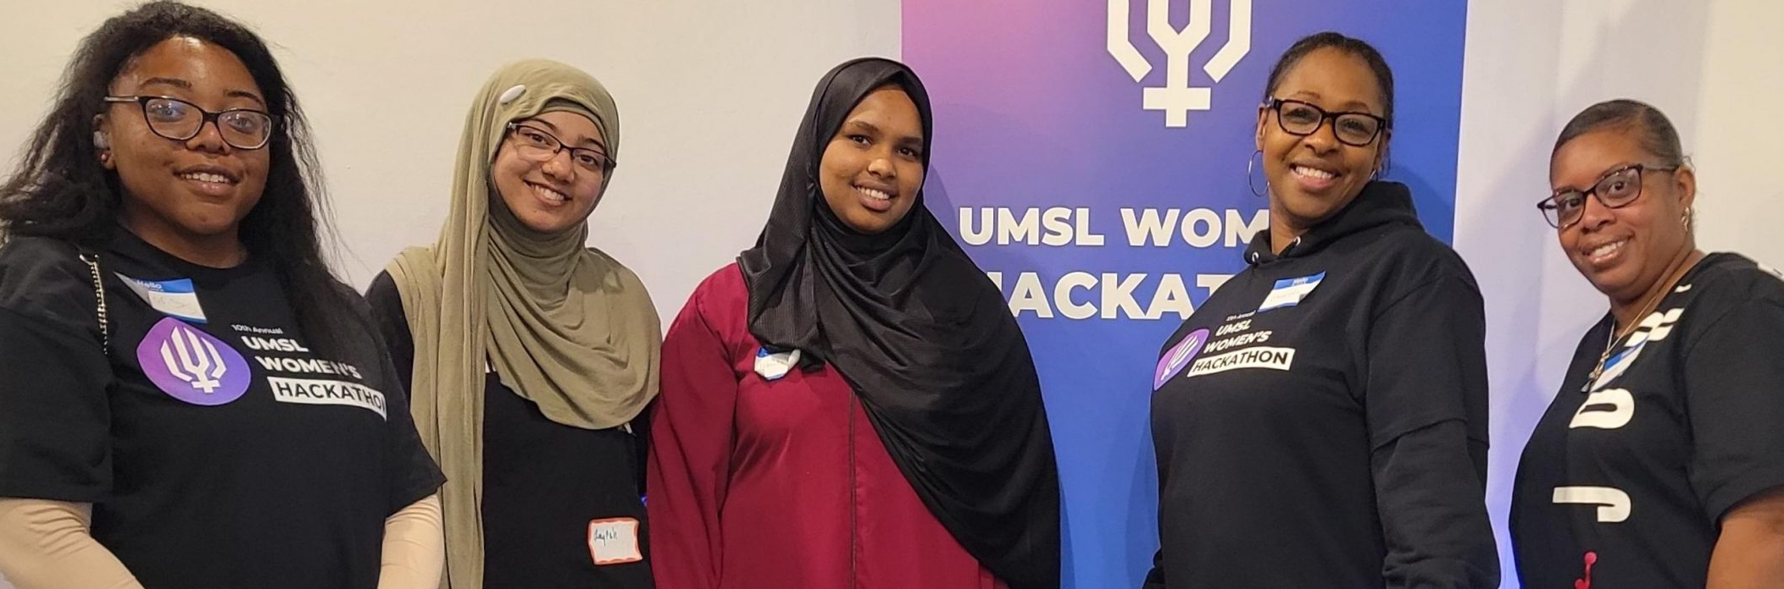
Why A Hackathon?
Promote diversity and inclusion in the tech industry.
Empower women to take on leadership roles and showcase their talents.
Foster a supportive environment for learning, growth, and networking.
Encourage innovative thinking to solve real-world problems.
Brought to you by
UMSL WOMEN’S HACKATHON 2025

Slide 4
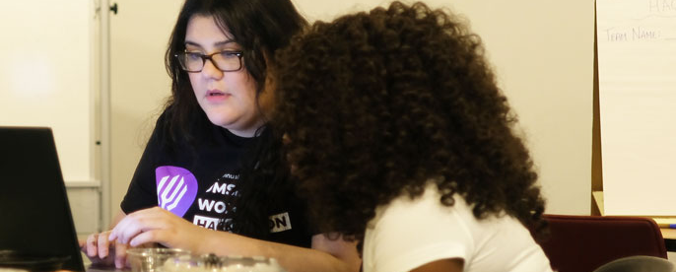
Networking Opportunities
Why should you network?
Networking Sessions
Job Fair
#UMSLWomensHackathon
#UMSLProud
#WomenInTech
#WomensHackathon
Brought to you by
UMSL WOMEN’S HACKATHON 2025

Slide 5
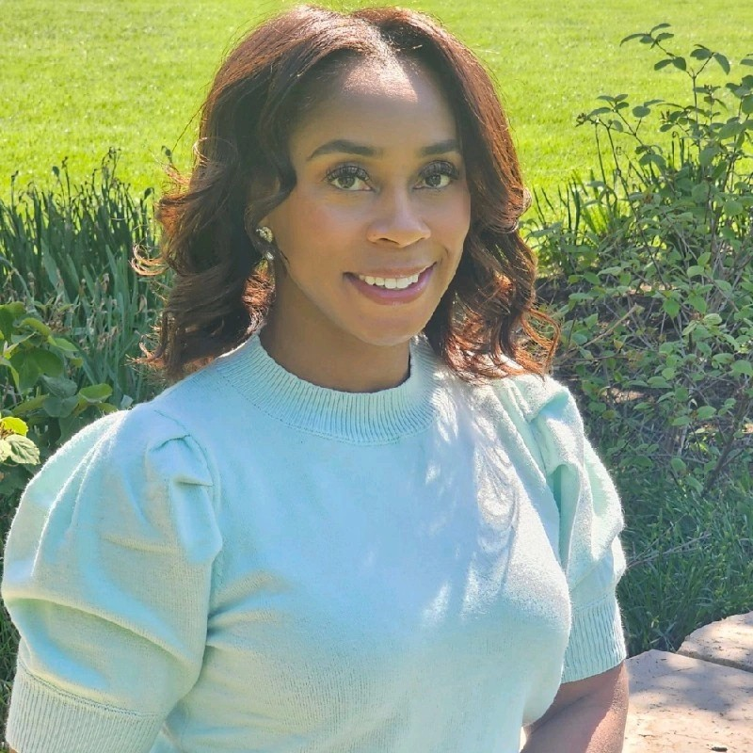
Geminia Morris
Keynote Speaker
Director of Retail Strategy & Provider Contracting at Express Scripts
IST Advisory Board President at UMSL
Possesses a strong passion for engaging women and minorities to explore education and career opportunities in the technology field.
Brought to you by
UMSL WOMEN’S HACKATHON 2025

Slide 6

Reinsurance Group of
America, Incorporated
rgare.com
Thank You,
Sponsors!
& Supporters!
This event is not possible without Sponsors, Mentors, Judges, Volunteers and Participants. Thank you all!
UMSL WOMEN’S HACKATHON 2025

Slide 7
1st Place $100 Gift Card for Each Team Member
2nd Place $50 Gift Card for Each Team Member
3rd Place $25 Gift Card for Each Team Member
Prizes &
Gifts!
Something for everyone!
Brought to you by
UMSL WOMEN’S HACKATHON 2025

Slide 8
Rules & Guidelines
Additional Information Provided In Event Documents
Details
Judging Criteria
Teams of 3 to 5 participants
Hack from 9:00AM to 4:30PM
Present solution in 3 to 5 minutes
Mentors available for guidance
Judges will choose three winners
Images will be taken during event
Creativity & Innovation
Technical Execution
Impact & Usefulness
Accessibility & Inclusivity
Scalability & Adaptability
Presentation & Communication
Brought to you by
UMSL WOMEN’S HACKATHON 2025

Slide 9
“Get the Word Out!”
Problem Statement
Design a next-generation mass communication solution that ensures information reaches the right people, at the right time, through the right channels – whether in emergencies, public events, or day-to-day interactions.
Brought to you by
UMSL WOMEN’S HACKATHON 2025

Slide 10
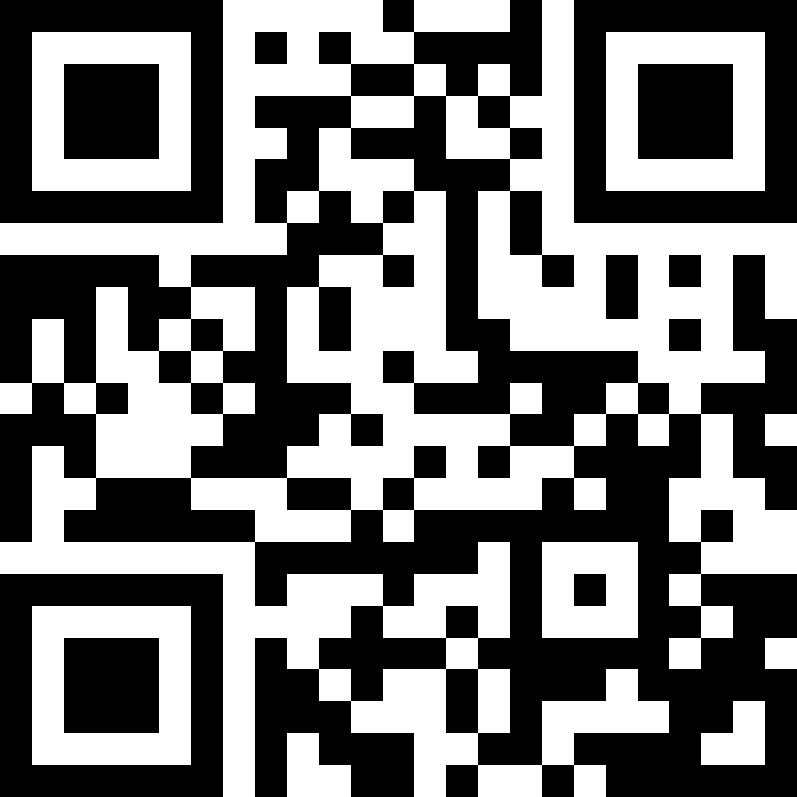

11th Annual UMSL
Hacking Rooms ABH 003 & 004
WOMEN’S HACKATHON
JOIN THE DISCORD for updates and resources:
Empowering #WomenInTech
2025
Brought to you by
Guest Wi-Fi Access:
Network: TritonNetGuest
ID: sbusmis@sbusmis.com
Password: 64448

